Slide 1
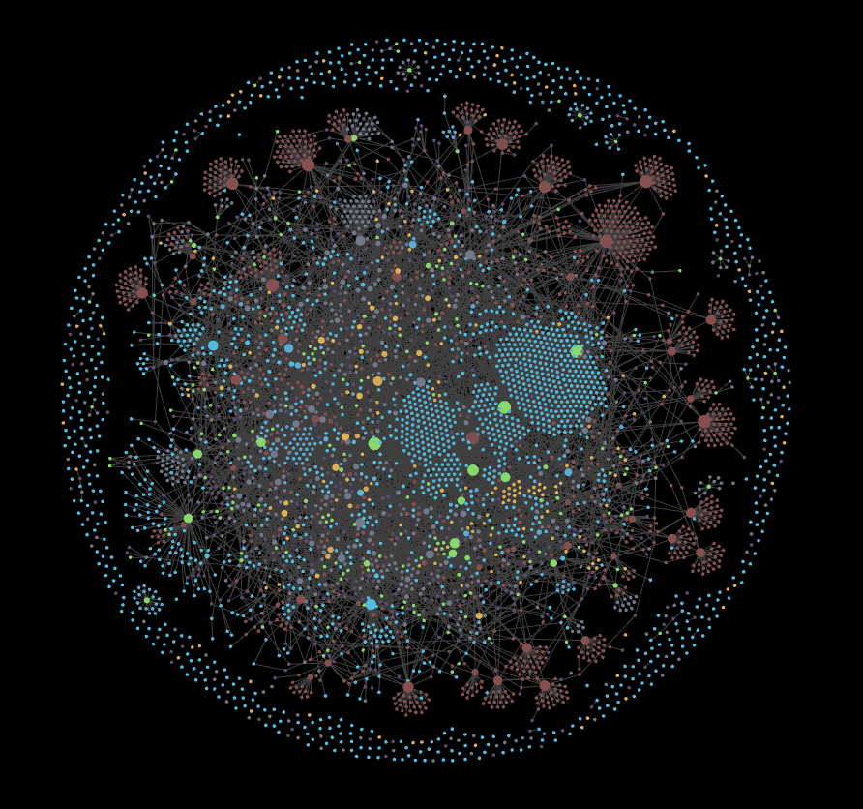
Phishing Attacks
understanding
a guide to cybersecurity awareness
Presented by: Sheikh Iyad
Cybersecurity Workshop - CodeAlpha
15th December 2025

Slide 2


What is phishing?
Phishing is a form of social engineering where attackers deceive individuals into providing personal information, such as passwords or financial details. It often spreads through emails, messages (SMS), and phone calls, posing significant cybersecurity risks.
Example: A fake email from your bank asking you to verify your account details.

Slide 3
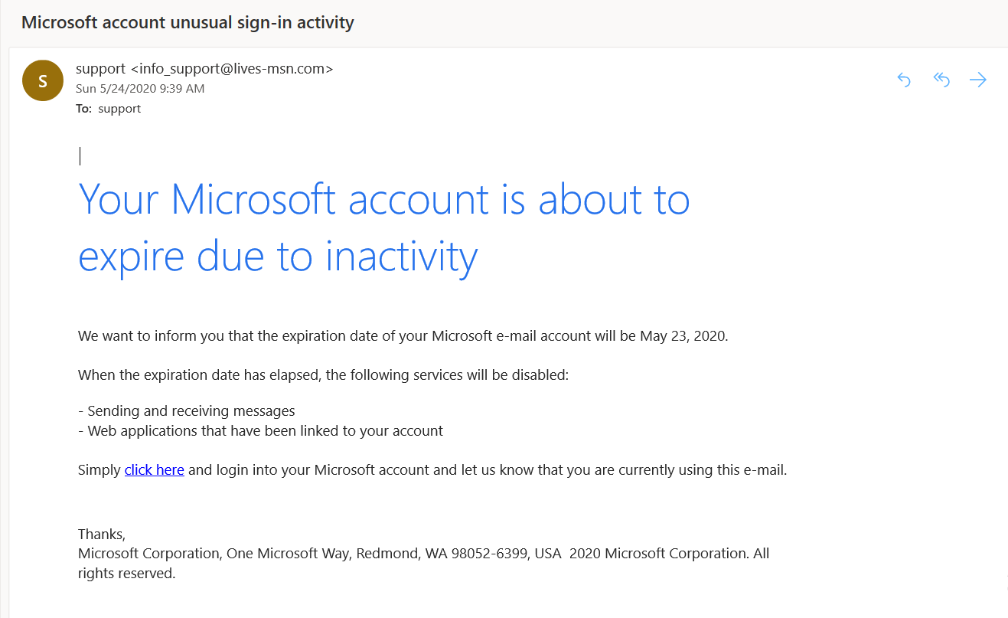
How does phishing work?
The attacker uses these common phases to deceive the victim:
Bait
Hook
Capture
1. Baiting: The attacker prepares an email or SMS and sends it to the victim.
2. Hooking: The attacker convinces his victim to click on a specific link where all the data can be entered.
3. Capturing: When the victim enter their data on the false link, all the data is captured and sent to the attacker.

Slide 4
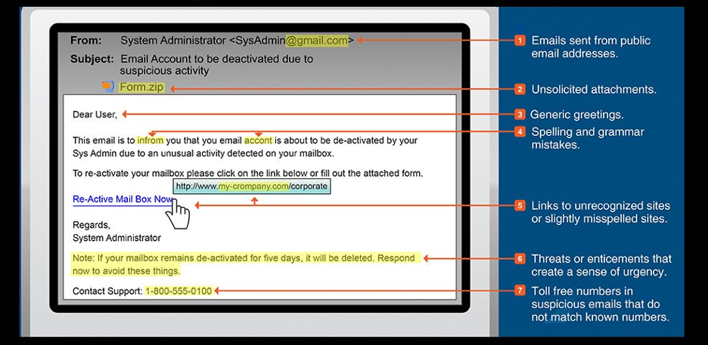
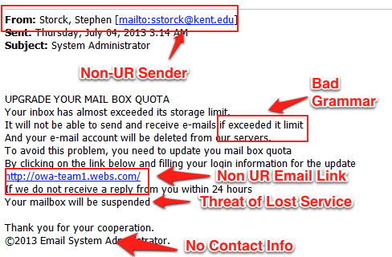
How to recognize Phishing?
Phishing emails and text messages often tell a story to trick you into clicking on a link or opening an attachment. You might get an unexpected email or text message that looks like it’s from a company you know or trust, like a bank or a credit card or utility company. Or maybe it’s from an online payment website or app. The message could be from a scammer, who might be demanding these.
To spot a phishing email, check for:
bad grammar and spelling mistakes.
Emails with an Unfamiliar Greeting or Salutation.
Suspicious Attachments (files like .exe, .zip, .7z, .bat)
Emails Demanding Urgent Action

Slide 5

Avoiding Phishing Emails
Your email spam filters might keep many phishing emails out of your inbox. But scammers are always trying to outsmart spam filters, so extra layers of protection can help. Here are four ways to protect yourself from phishing attacks.
Avoid emails from bank as many as you can, visit your local bank if there’s any action required.
Visit official sites directly and look if any action is required.
Protect your computer by using security software.
Protect your cell phone by setting software to update automatically.
Protect your accounts by using multi-factor authentication.
Protect your data by backing it up.

Slide 6
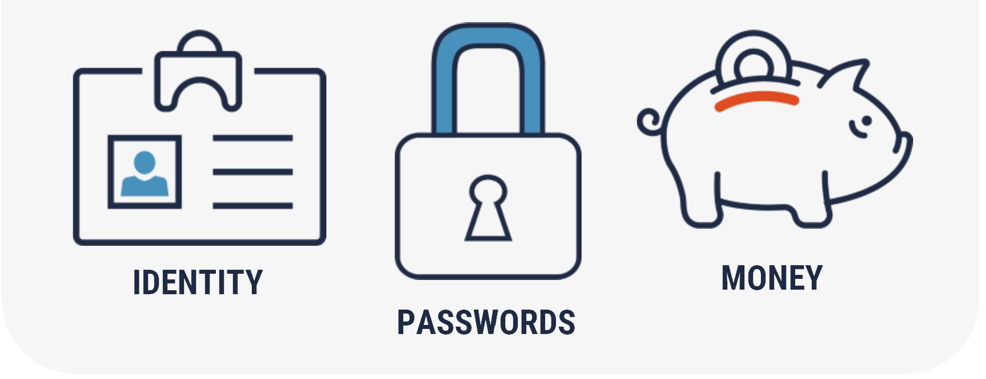
What to do if you got phished?
Victims of phishing may wonder what to do after their details have been compromised. There are numerous steps that can be taken which may mitigate the damage from the attack, stop other people from becoming phishing victims of the same scam, and even protect the victim from future attacks. Here are some things to consider.
Figure out what happened: Victim needs to understand how the attack happened.
Contact the compromised authority: Victim needs to contact the authority/company to secure all the compromised data as soon as possible to prevent more damage.
Update any compromised passwords: Change the passwords of potentially compromised websites.
Run a full scan on compromised device: Run a full scan from the anti-virus installed in the device.

Slide 7
Conclusion
Phishing attacks are one of the most common cyber threats today, targeting individuals and organizations alike. The key to staying protected is awareness and vigilance. By recognizing phishing attempts and understanding their tactics, you can safeguard your personal information and help prevent cybercrime.
Key Takeaways:
Think before you click – Avoid suspicious links and attachments.
Verify the source – Always double-check emails and messages from unknown senders.
Secure your accounts – Use strong passwords and enable multi-factor authentication (MFA).
Stay updated – Be aware of the latest phishing techniques.
Remember, cybersecurity is a shared responsibility. Stay informed, stay alert, and help spread awareness to keep the digital world safer for everyone.

Slide 8


